Slide 1


Call log analysis
Romauli Butarbutar
Willey Chen
Inna Logunova
Aansh Mehta
Danni Tian
Steven Tong
Daisy Wen
Zhengjia Xu

Slide 2

Problem statement
The city government of New York City is tasked with:
Allocating finite resources towards a seemingly infinite set of problems.
Overseeing many different tasks that touch every aspect of resident’s lives
NYC 3-1-1 is a service channel that allows New Yorkers to access government services and to file complaints via multiple platforms:
Phone calling
Texting
Other social media (About NYC311).
Each call creates a wealth of data but it is not readily usable in the raw format.
Notes:
A description of the chosen scenario with all applicable details and requirements set forth by your client.
Aansh

Slide 3
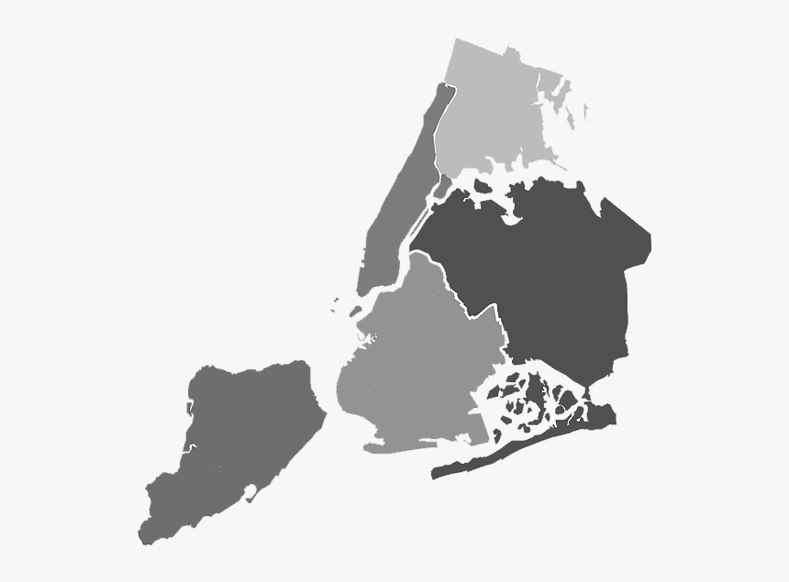
Proposal
Focus on three dimensions:
CLIENT:
Understand if there are specific service request categories that have a high rate of problem solving in a short duration.
Using that information to decide on categories which are suitable to incorporate automation.
Work with the departments to decide on budget and spends
New York City Municipal Government
Our team aims to help the NYC government to:
relieve the stress of the call center
allocate public resources efficiently
maintain quality of service & reduce labor cost by incorporating tools such as call automation.
Help managers, and executives make informed decisions
Notes:
Details on the plan you proposed to your client and how the company will benefit from the database system and processes that you committed to implement.
1. Proposing to our client a new database system. 2. The government in different levels utilize rich raw data from 311calls to inform better decision.
Our goal is to help nyc gvt: stress, service need ) 3. Financial wise, to make sure the feasibility of the proposal
Willey

Slide 4
Team structure and Timeline
Each member took the lead on the checkpoint they volunteered for. Also, a timeline of activities highlighting the most challenging tasks.
Challenging Tasks
Aansh
Challenging Tasks
Daisy
Danni
Outlining the 15 tables
Categorizing 41 variables
Setting the PK, FK and adding new FK
Duplication of efforts
Making sure the code worked
Aansh
Daisy
Romauli
Steven
Willey
CheckPoints
Willey
Zhengjia
1
2
3
4
5
Challenging Tasks
Challenging Tasks
Challenging Tasks
Inna
Danni
Finding a platform that would allow us all to communicate.
Outlining the 15 tables
Categorizing 41 variables
Setting the PK, FK and adding new FK
Filtering useful information from the large dataset (27.1M data)
Connecting the database to BI platforms
Willey
Romauli
Zhengjia
Steven
Notes:
<a href="https://storyset.com/people">People illustrations by Storyset</a>
Steven

Slide 5
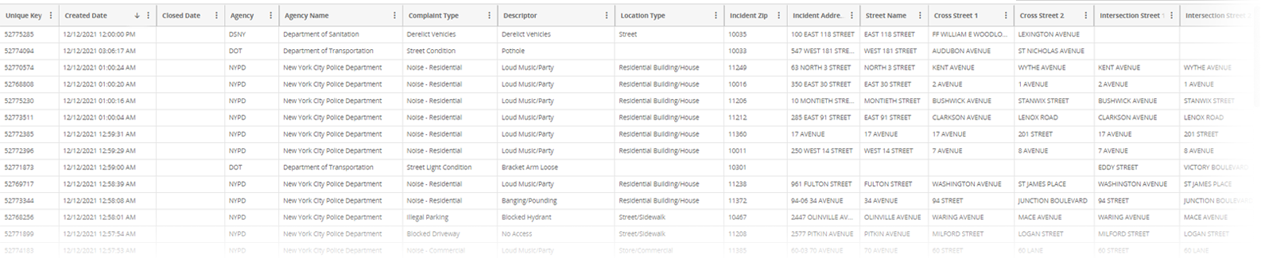

Data schema
Our original data consists of: 41 columns and 27.1M+ rows
1NF
2NF
3NF
41 columns to start
Separated into four big categories:
Service request
Responding agency
Complaint details
Location
Separated categories into more tables specific to the four big categories
Separated location fields down to 10 more tables
ETL process
For the etl process, we decided to use python notebook as the insertion method. Some difficulties we encountered were getting the code to work.
Notes:
Uli
In the 1NF, with 41 columns available, we will make sure each record in the dataset is unique, and categorize them into four big categories: The service request, The responding agency, The complaint details, and The location of the request.
After the 1NF, we can now be more specific on other details for the 2NF. We will create the service request table to record requester information, such as what service they are requesting, the channel they are connecting from, the start and the end date of the request. Second, we will create the complaint table. With hundreds of complaint types, we want to know what the most complaints are about. Third, we can create the agency table to collect agency information. Then we can measure each department's performance, and provide proper training. Fourth, as we understand the requester and responder, we will record location details in the location table. Thus, we can better allocate the government resources region by region.
Now, we can move on from the 2NF to the 3NF. Since there are tens of columns describing the location details of each incident, we can create 10 more tables based on location, such as location by requester, by specific geo-coordination, by transportation, by community etc,. For the complaint details, it contains details about resolutions. We will take resolution details from the complaint category to the resolution table in order to check the progress of the service request. While each agency, or department, can receive different types of complaints, we will have an agency _complaint table to document the details. In this stage, the 15 table creations are completed.

Slide 6
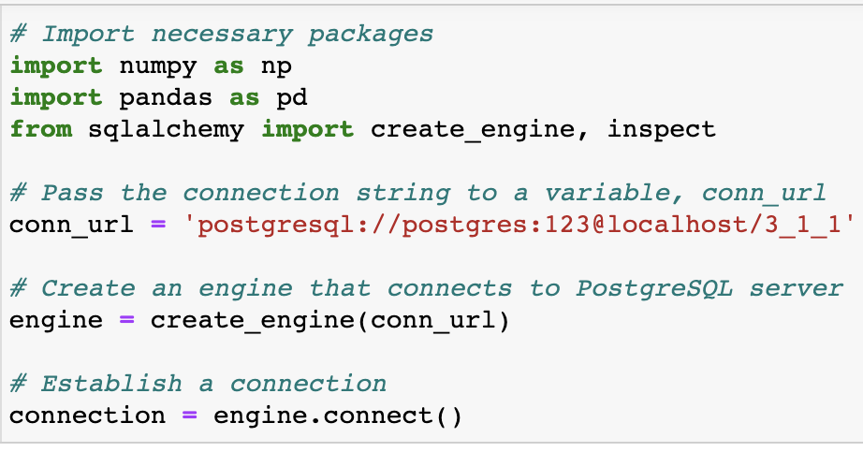
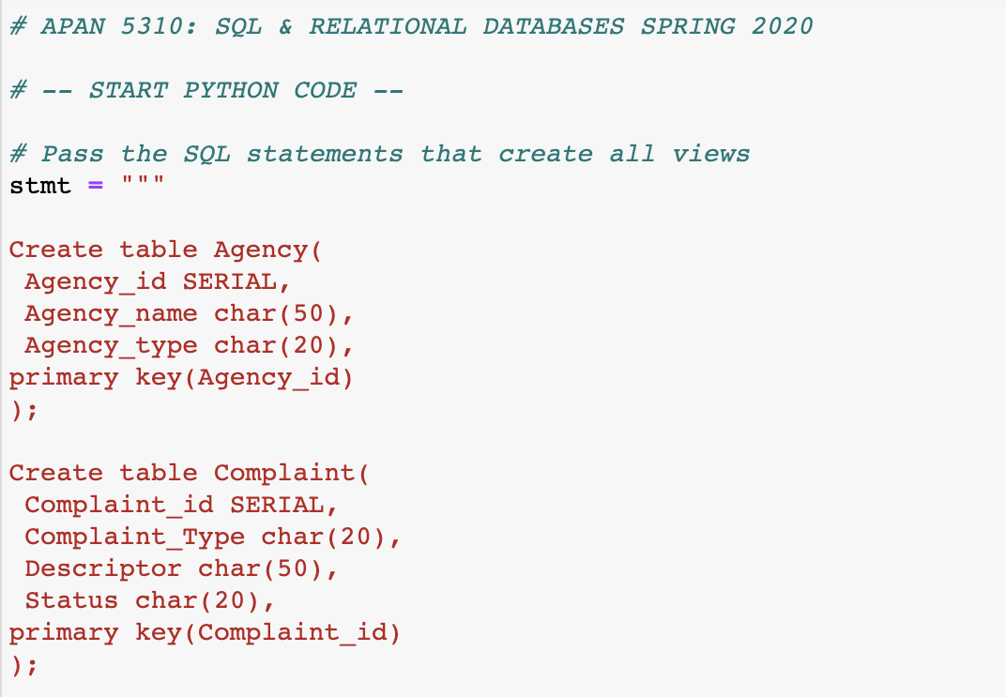
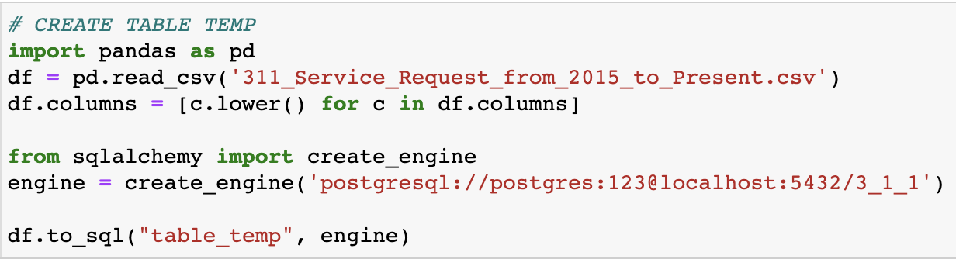
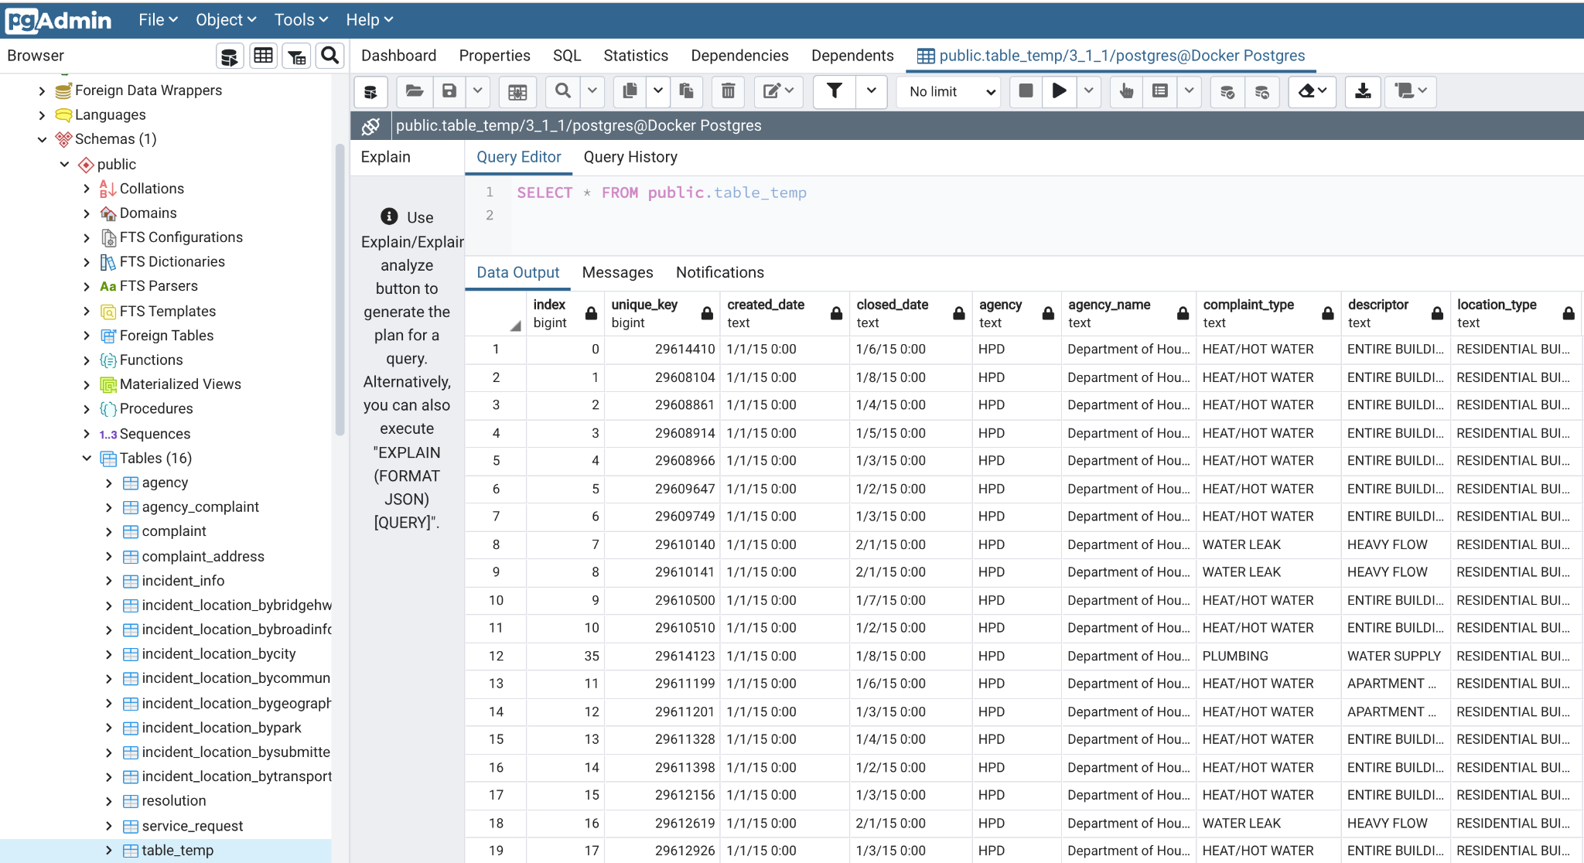
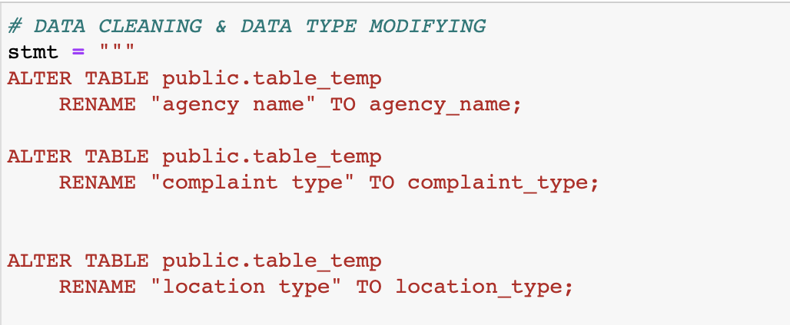
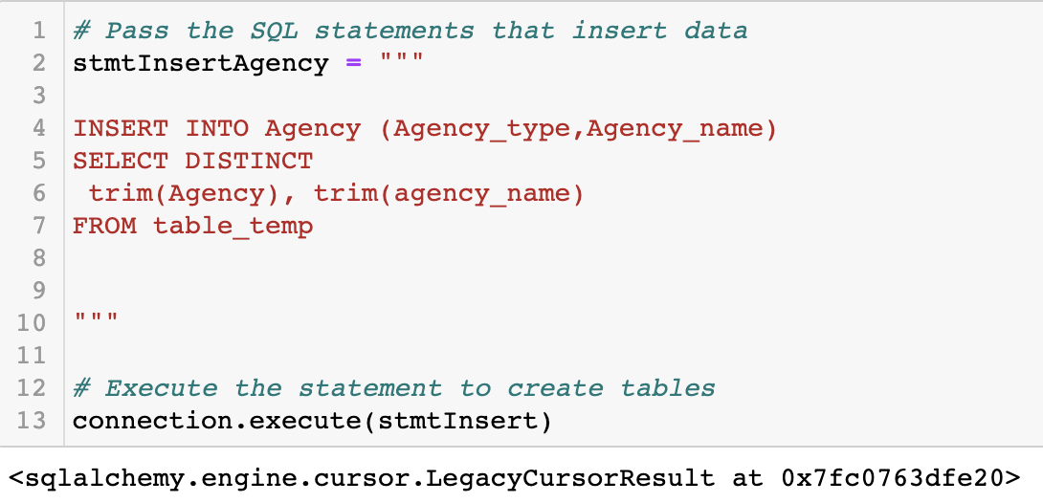
ETL PRocess - PYTHON CODE
1
2
3
Import Packages & Creating Connections
Creating Temporary Table for Raw Data (import csv file)
Creating Table
4
5
Data Cleaning & Data Type Modifying
Inserting Data
Notes:
Uli

Slide 7
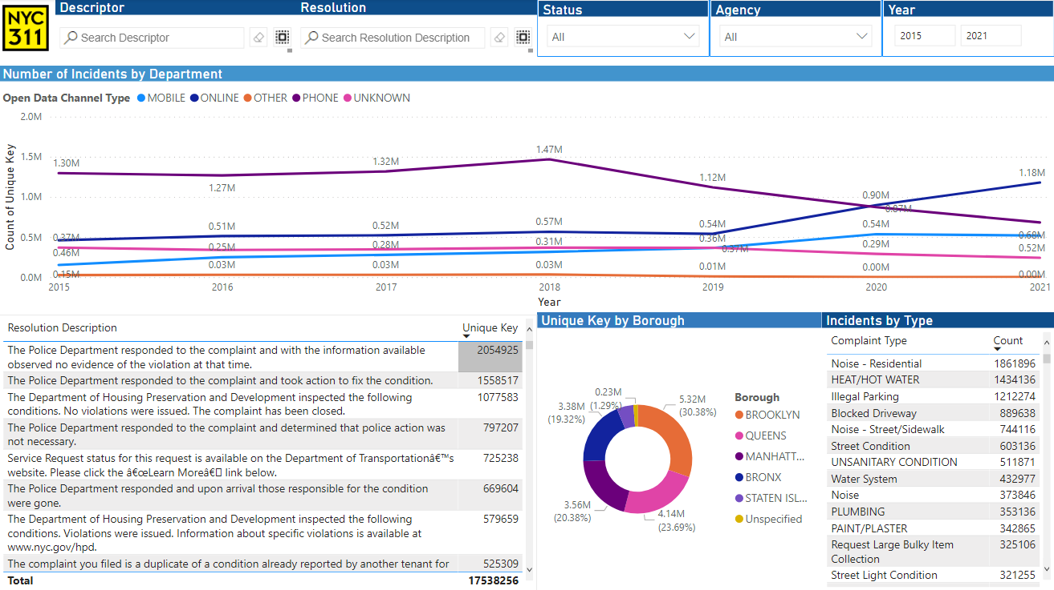
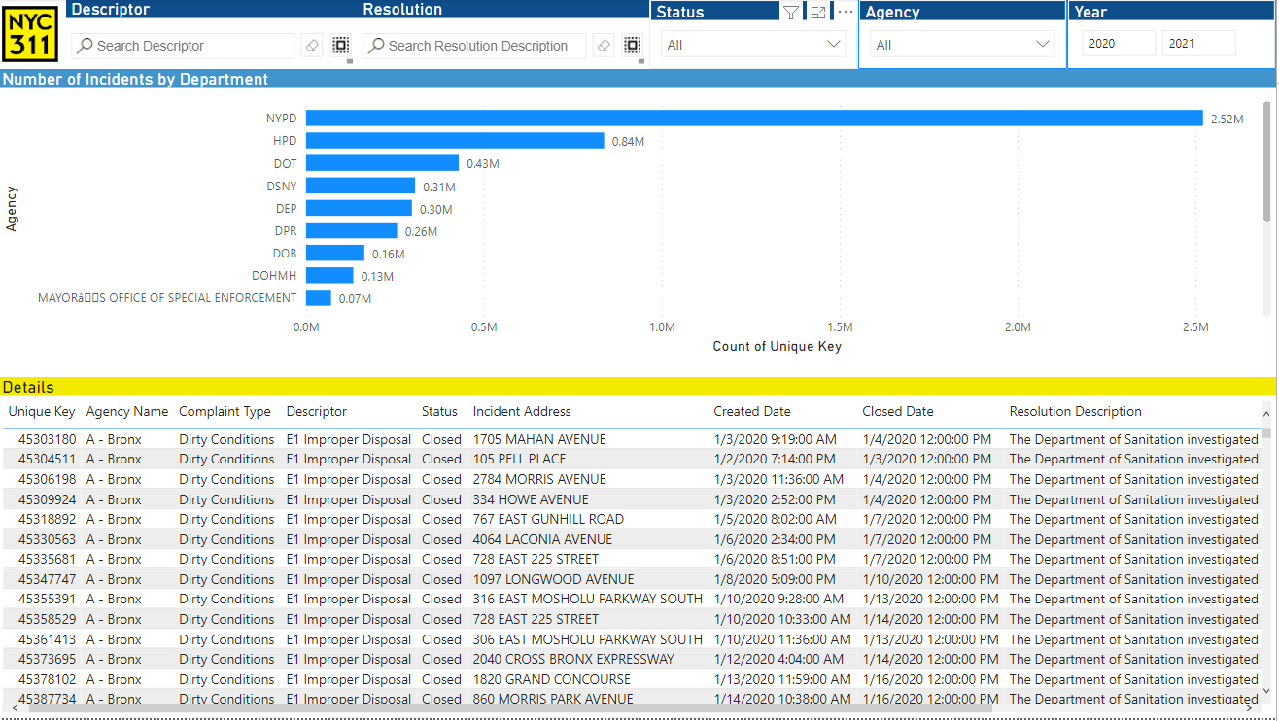
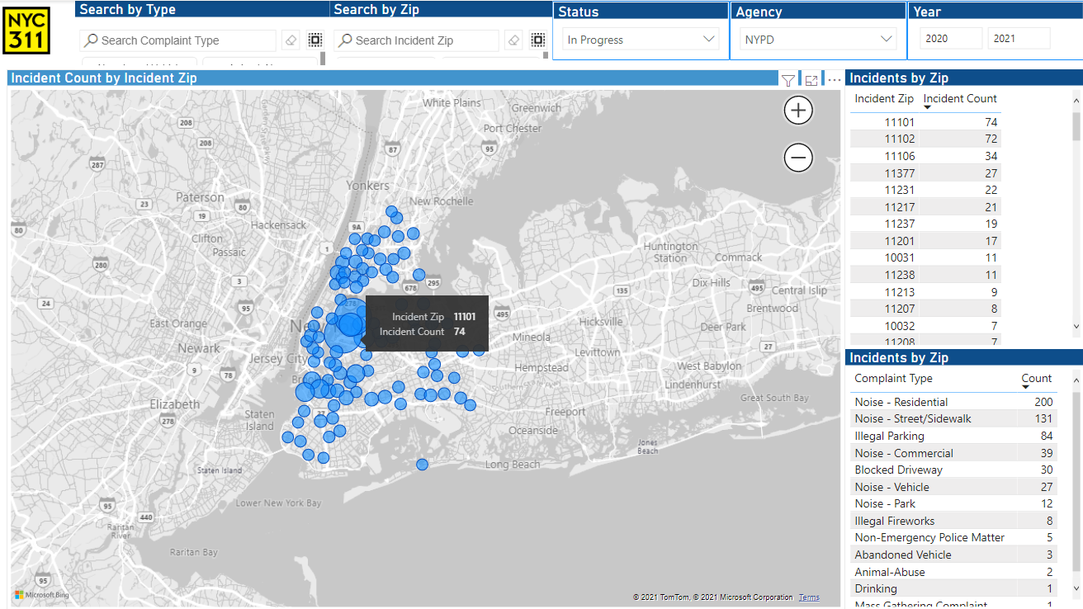
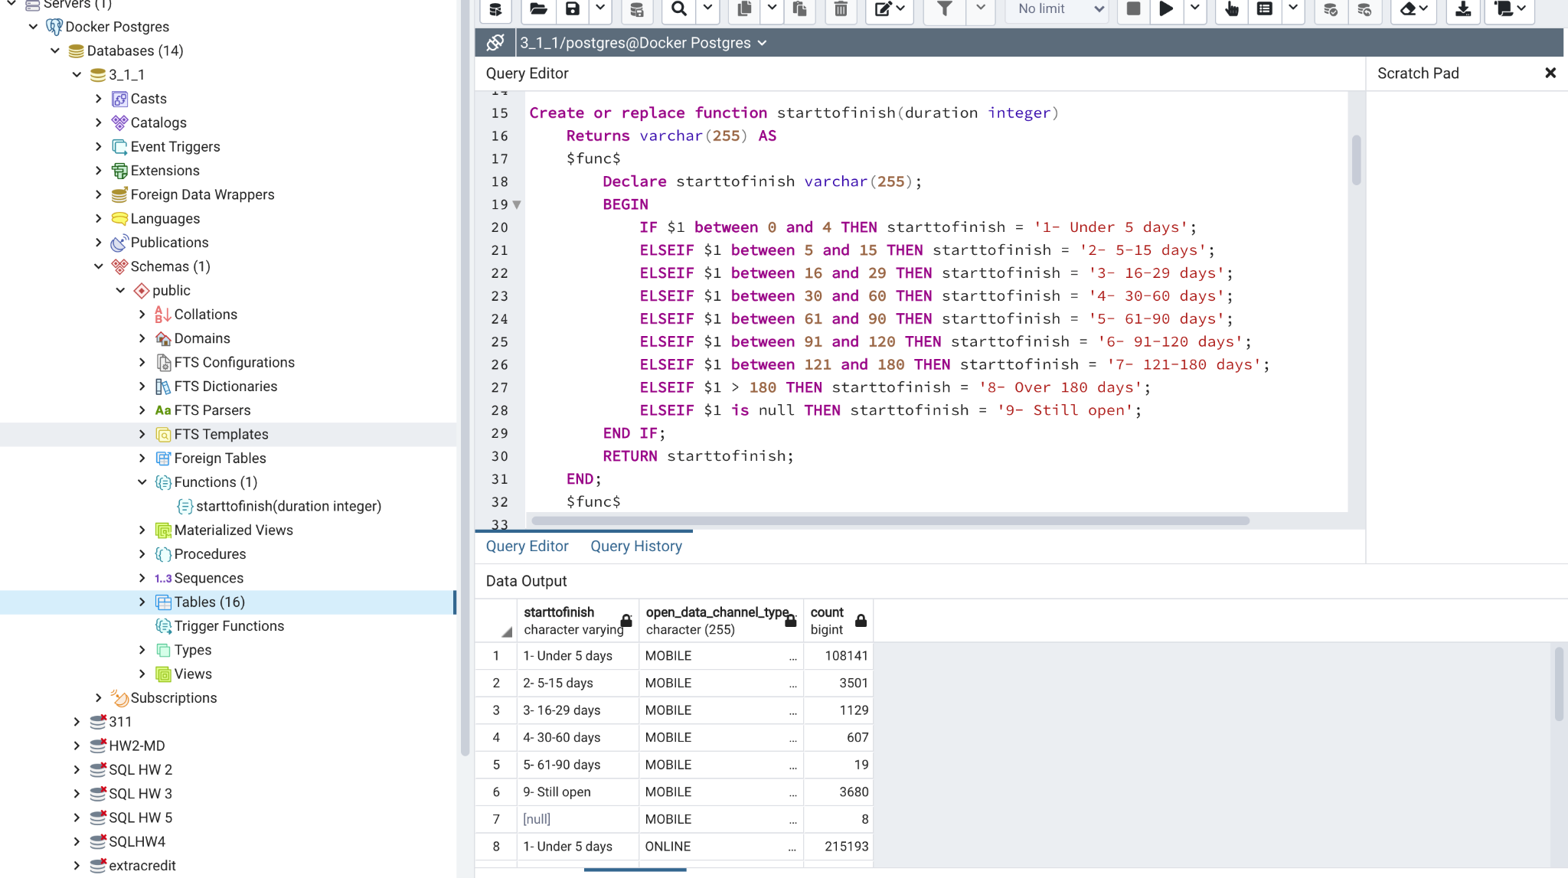

Customer interaction plan
ANALYST
Access to views/schemas
Direct querying in database or PowerBI dashboard search.
MANAGER
Direct querying in database or PowerBI dashboard search
Department based with internal information connected.
Summarized data with ability to drill into more information
EXECUTIVE
Big picture /summary level reports
Overview of department
Future recommendations include adding financial data
Notes:
While you are not required to build specific applications, you must explain how you will cover the needs of your client besides designing the backend database system.
Process of interacting with data (analytical procedures):
Why? What are the customer needs that you designed for? What are the insights that your customer is expected to benefit from with the new relational database and relevant tools that you build for them?
How? Did you build custom tools? (raw SQL, Python, R, Metabase, other)
Very brief demo of database interaction (SQL and Metabase)
Daisy

Slide 8

Q & A
Notes:
While you are not required to build specific applications, you must explain how you will cover the needs of your client besides designing the backend database system.
Process of interacting with data (analytical procedures):
Why? What are the customer needs that you designed for? What are the insights that your customer is expected to benefit from with the new relational database and relevant tools that you build for them?
How? Did you build custom tools? (raw SQL, Python, R, Metabase, other)
Very brief demo of database interaction (SQL and Metabase)

